Slide 1


SAP CLOUD APPLICATION PROGRAMMING AND XSA TRAINING IN BTP
Anubhav Oberoy
Day – 9

Slide 2

Agenda – Day 9
Adding Filter Fields and Columns using annotation
Adding Custom Columns and Formatting Column Values
Deployment of the Application
Steps to deploy on CF
Security Basics
Authentication and Authorization
What is XSUAA?
Basics of xsuaa
IdP – Identity Provider
What is JWT?
Concept of App Router
Understanding how app router works

Slide 3
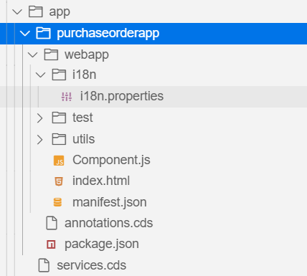
Understanding the Generated Project
The project will be created inside the app folder of our main project. It will contain the UI5 project folder and a .cds file.
This services.cds file will point the annotations.cds file in the purchaseorderapp folder.
The main project folder contains webapp folder, annotations.cds file and package.json
Annotations.cds: - In this file we will create our applications user-interface with the help of UI annotations.
webapp folder: - It contains the starting point of the application (index.html), application descriptor (manifest.json) and component.js file.
package.json: - It contains the information about the dependencies used by the project.
Component.js: - It contains the linkage to the manifest.json file.
Manifest.json: - It contains all the information about the application like, service binding of app, views, models, templates used to build app, routing of the app, etc.

Slide 4
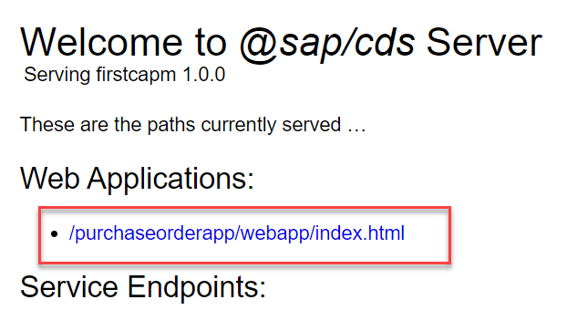
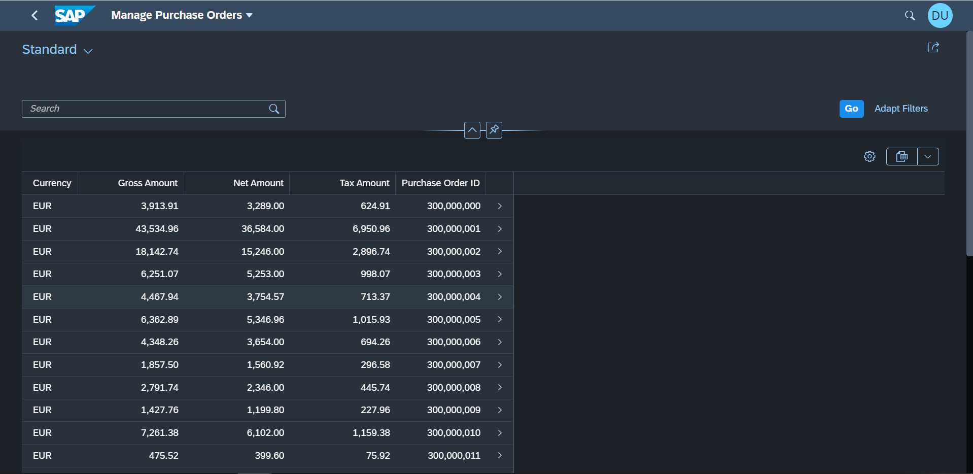
Hands-on: Create LRP using template
Create a list report application in our firstcapm project using the template wizard. Follow the steps given on the previous slide and fill all the information as specified.
Once the application is successfully generated we can run the app using the command cds run or cds watch.
The application endpoint will be available in the Web Application section.

Slide 5
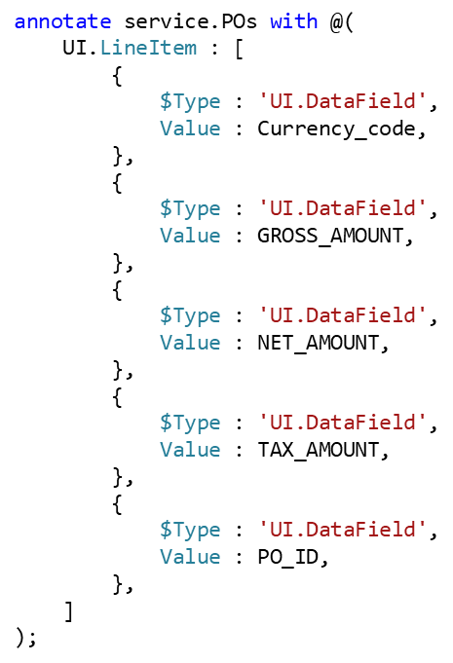
What are SAP Fiori Annotations?
SAP Fiori elements apps are generic frontends, which construct and render the pages and controls based on annotated metadata documents. The annotations provide semantic annotations used to render such content, for example:
In this example we have specified the Table columns with the help of UI.LineItem annotation.
We can use different annotation form the SAP Vocabularies to add specific items to the UI.
The most commonly used Vocabularies are
UI.SelectionFields: It is used to add the filter field in the Smart Filter Bar.
UI.LineItem: It is used to add the Columns in the Table.
UI.HeaderInfo: It is used to add the header information in the UI
UI.Facets: It is used to create the Facets in the UI.
UI.FieldGroup: It is used to Group the data field and Input field in the UI. It is like the form control.
We can get more information about the Annotations with the help of Documentation: https://cap.cloud.sap/docs/advanced/odata#vocabularies

Slide 6
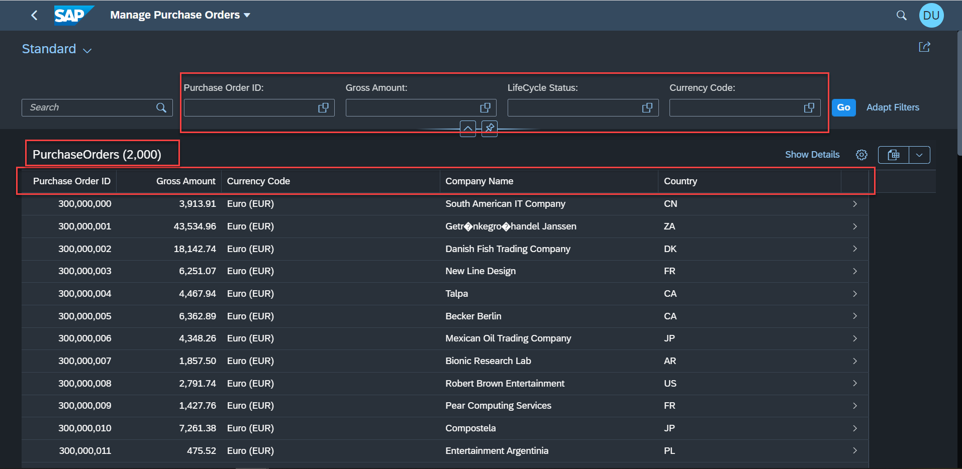
Hands-on: Adding Custom Filters and Columns
Create custom filter fields in the smart filter bar and add custom columns to the List Report Page using the annotations. Along with that we will also add header info to the Table.
Exercise code/resources:-
annotations.cds

Slide 7
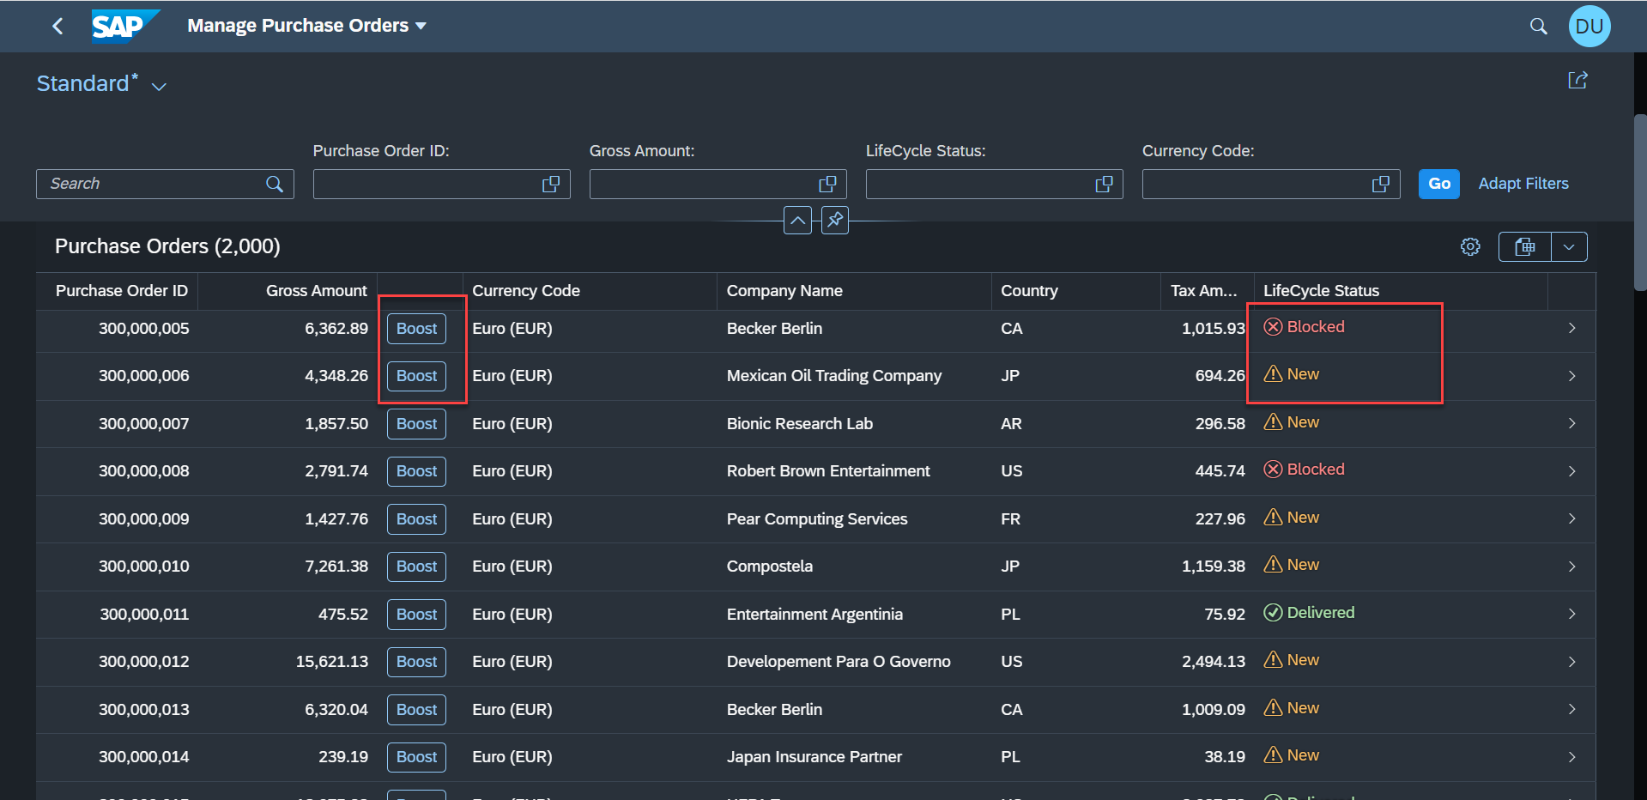
Adding custom Columns to Table
Some time we want to show the data to the user in more fast and convenient manner. For that SAP provides the criticality annotation, using this we can add some visual stuff to our line items like icons, ratings etc.
When you want to attract your business users attention, UI.Criticality is one of the easiest annotations you can use to add some visual bling to your Fiori elements apps. It’s a great option for adding a status icon and a little semantic color to a simple text or date field.
For that we will use the criticality annotation provided by SAP.
So now we want to add a new column and in that column we will add a button to use the boost action we have implemented for the purchase order.
Also we want an status icon to show the Life Cycle Status of the purchase order.

Slide 8
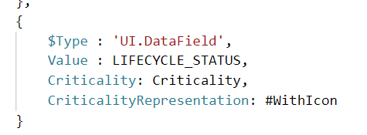
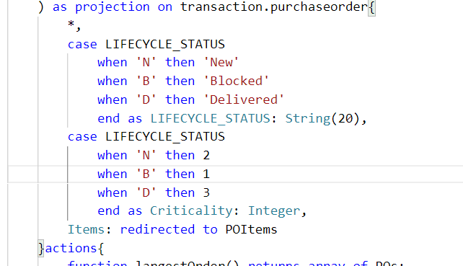
Hands-on: Criticality and Custom Action Button
Add a Criticality annotation to the Life Cycle Status Field and also add a button to boost the Gross amount using the custom action.
Exercise code/resources:
annotations.cds
CatalogService.cds

Slide 9
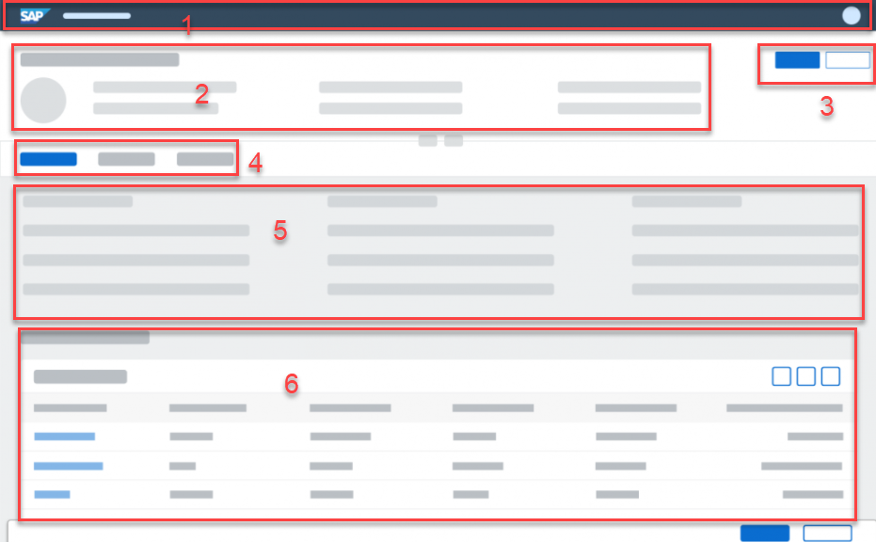
Object Page
The object page floorplan is used to display and categorize all relevant information about an object. Categorized content can be accessed quickly using anchor or tab navigation, and users can switch from display to edit mode to change the content.
Object Page Contains the following Items:
Navigation Bar
Dynamic Header
Action Buttons (Delete, Update)
Facets
Content Area
Line Items Table
Footer Bar

Slide 10
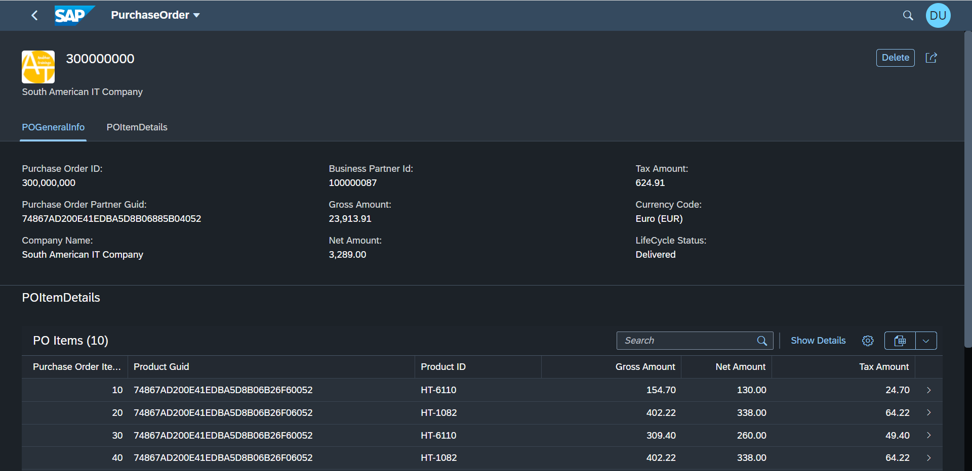
Hands-on: Object Page
Create an Object Page with the help of annotations.
Exercise Code/Resource:-
annotations.cds

Slide 11
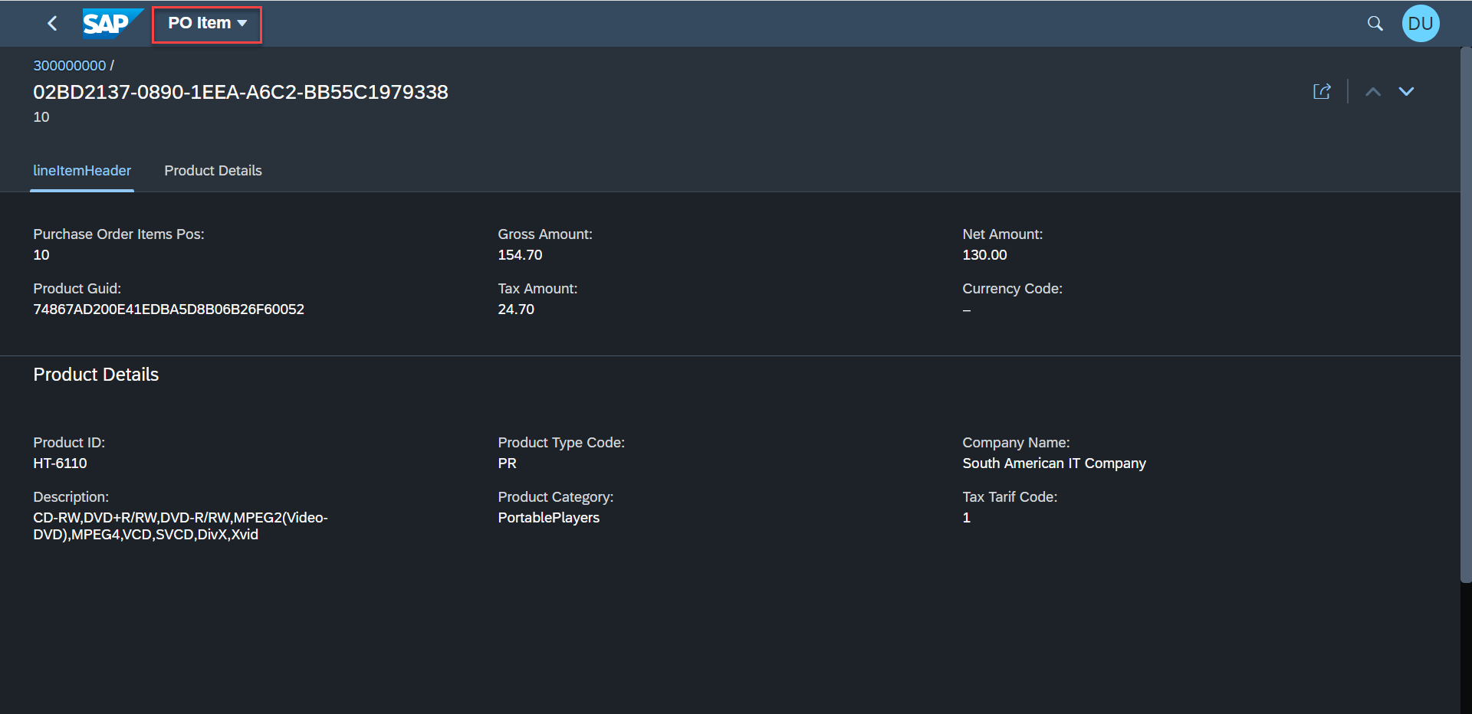
Hands-on: Third Level Drill Down
Create a new Object Page for the Purchase Order Item details.
Exercise code/resource:-
annotations.cds

Slide 12




























Slide 13
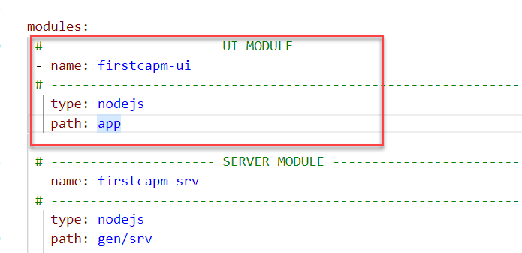
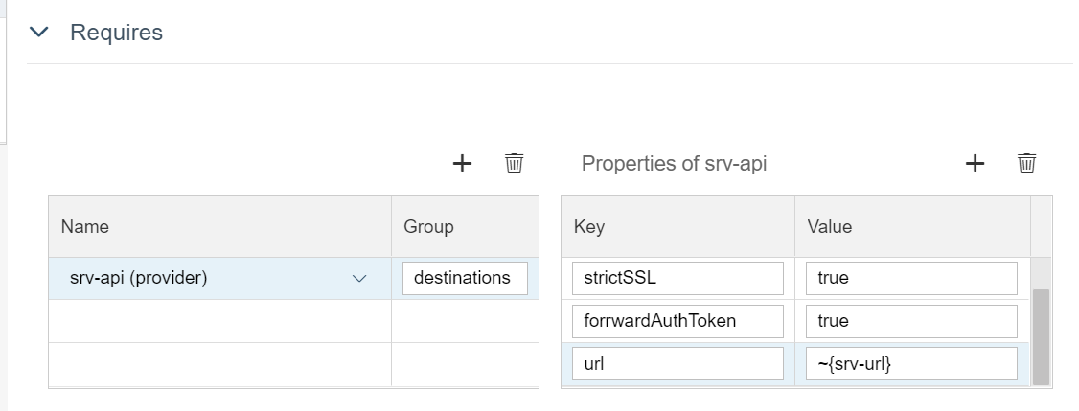
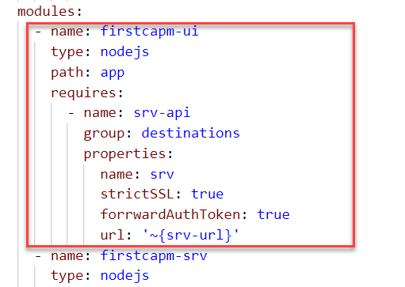
Deployment
CAP applications can be deployed to the Cloud Foundry environment of SAP BTP. At the end, it’s about deploying Node.js and Java applications, and about creating and binding appropriate service instances.
For clean, production-like (pipeline) builds and deployments, we enhance our application to become a Multitarget Application (MTA). The Cloud MTA build Tool creates a self-contained MTA archive, packaging the different parts of the application (database, service, and UI).
Create the MTA development descriptor mta.yaml in the project’s root: cds add mta (*if the file is not already present). If the file is already present we can skip this step.
Add a New UI module to the mta.yaml file using the mta editor tool, because by default the generated mta.yaml file doesn't contain the UI module in it .
Add app router to the UI application to navigate the application in Cloud Foundry.
Package the application in a mta archive file to reduce the size of the application. Use command mbt build to build the complete application.
Deploy the generated mta archive file by right clicking on the file and press Deploy MTA.
Configuring the MTA File for UI Module

Slide 14





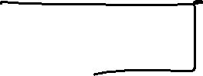





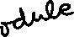































Slide 15
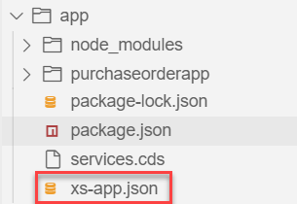
Adding App Router to the Application
The application router is the single point-of-entry for an application running in the Cloud Foundry environment on SAP BTP. The application router is used to serve static content, authenticate users, rewrite URLs, and forward or proxy requests to other micro services while propagating user information.
Steps to add app router:
Go to the app folder of the main project and move to the package.json file out form the webapp folder to the app folder.
Open the app folder of our main application in the terminal.
Install the SAP App router using the command: npm install @sap/approuter
Add a new start script in the package.json for the app router
“start”: “node node_modules/@sap/approuter/approuter.js”
Add a new file named xs-app.json in the app folder.
Configure the xs-app.json file. Code link:
Once the app router and xs-app.json is added then build the app using the mbt build command and then deploy the generated mta archive.

Slide 16
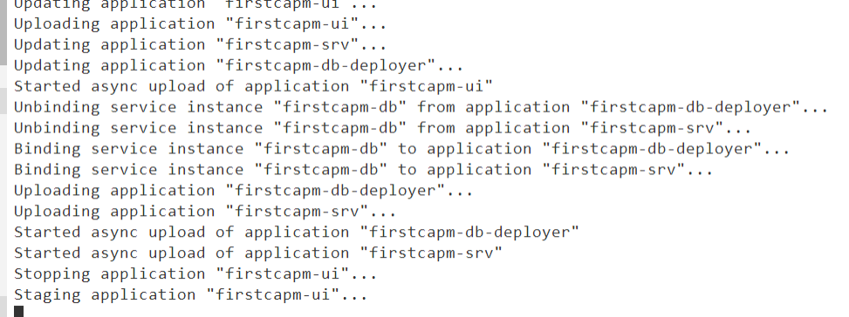
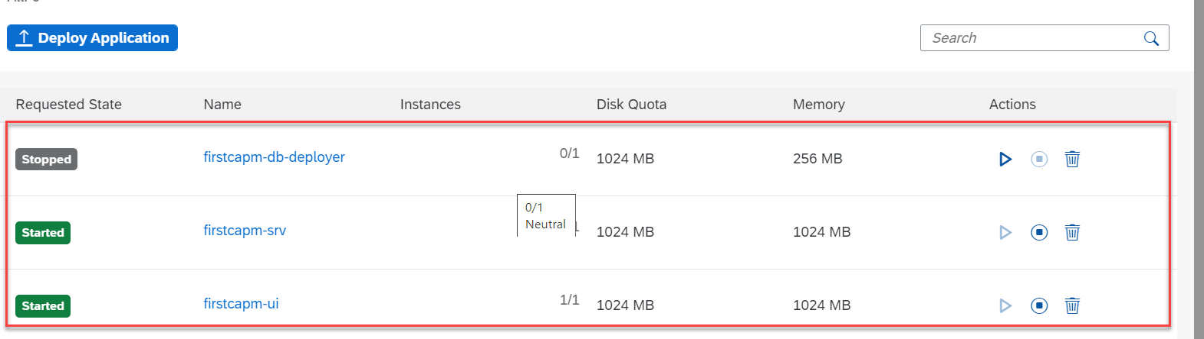
Hands-on: Deployment
Deploy our capm application to the cloud foundry, follow the steps provided in the previous slide to complete the deployment.
Exercise code/resources:
mta.yaml
xs-app.json

Slide 17

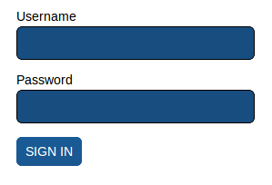
Security Basic
User account and authentication (UAA) is the process by which an application identifies a user, verifies his/her identity and then checks if he/she has the required permissions to access the application. This process is essential in ensuring the security of an application.
Every application must be able to:
Identify a user (to be able to hold user data and distinguish different users by a unique ID)
Authenticate a user (to be able to prove the identity of a user based on a user-secret shared with the application)
Assign authorizations to a user and enforce these (to be able to define, assign and enforce policies of system-usage)
Identification
Authentication
Authorization
App
User
Check the Username, email and password of the user
Check if the user is a valid user
If the user is valid, then grant him the roles and permissions

Slide 18
Authentication V/S Authorization
Identification – Making a claim about who you are (via username, e-mail, etc.)
Authentication – Proving you are who you claim to be (via password, certificate, token, single sign-on, etc.) SAML 2.0 is protocol used for authentication.
Authorization – Authorization is the function of specifying access rights/privileges to resources. Authorization allows what you can do on the system, once you have been authenticated. OAuth 2.0 is the protocol used for authorization. We can configure authorizations using roles and role collections for your subaccount or individual applications.
XSUAA – User Account and Authorization
This is a in-built component inside of SAP CF
It is responsible to control the User account and Authorization
In Cloud Foundry, we can use a modular concept for managing Authorizations
We need to register our Scopes, Role Templates related to the app with XSUAA
Communicates with IDP
Issues JWT Tokens which is then injected in our App which has information about Scope(Role) user has
Scope
(Role)
Role Templates
Role Collections
* *
* *
* *

Slide 19
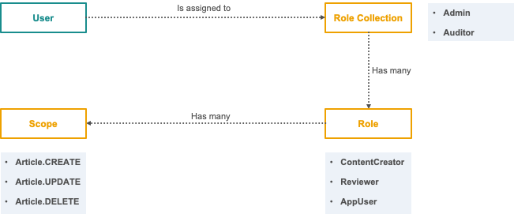
What is XSUAA?
The XSUAA is one of the most important component to deal with when developing your own applications on Cloud Foundry. It takes care to authenticate and authorize your business users and assign the right principals to your user’s session so your application can:
Identity the user by Email, UserId, First and Lastname
Check his roles (scopes) to decide if a user is allowed to do something or prohibit is action
The XSUAA is an internal development of SAP. SAP took the base of the open source UAA Oauth2 Provider of Cloud Foundry (https://github.com/cloudfoundry/uaa) and extended it with SAP specific features to be used in SAP applications. One important thing is that the XSUAA does NOT store “real” users. This is why the XSUAA needs to trust an external Identity Provider (short “IdP”).
Role-Collections, Roles and Scopes these terms are introduced by the XSUAA within Cloud Foundry.

Slide 20
IdP – Identity Provider
Identity providers (IdP) supply the user store for your business applications or for your subaccount. You can re-use existing corporate identity management infrastructure (on-premise or on the cloud), or use the default one (SAP ID service). You can have a different identity provider for each subaccount you own, and this feature is configurable using the cockpit.
Portal
Launchpad
XSUUA
Backing Service
JWT Token
Employee Portal
SAP Service
User
Our CF Apps
Outlook
User Info
Authenticate
User
SSO (IdP)
Stores Username, Email, Password.
Has trust relation ship with the apps.
It also stores the scope of the user:
Manager, Emp, CEO, SEO etc.

Slide 21
What is JWT(JSON Web Token)?
JSON Web Token (JWT) is an open standard (RFC 7519) that defines a compact and self-contained way for securely transmitting information between parties as a JSON object. This information can be verified and trusted because it is digitally signed. JWTs can be signed using a secret (with the HMAC algorithm) or a public/private key pair using RSA or ECDSA.
All the specifications put apart there are two things you need to know. A JWT consists of three main components that are declared as plain JSON:
header: Declaration of the used hashing and signing algorithms
body: Might be anything, but in our case it is the information about the user, the issuer and all the scopes.
signature: The signature allows the integrity of the JWT. The XSUAA will put the header of the ticket together with the content
All these parts can then be combined together and converted with base64 so its easier to add them in other data structures.
To know more about the JWT (JSON Web Token) you can read the documentation over here: https://jwt.io/introduction/

Slide 22
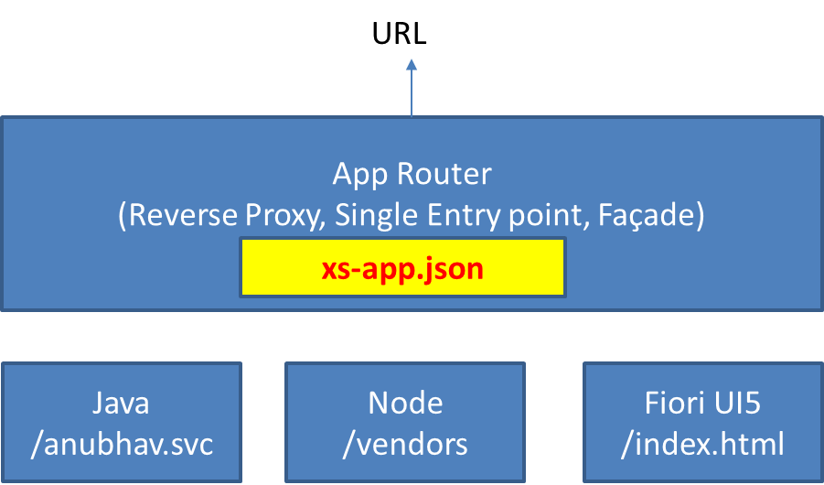
App Router
Instead of letting the customer access this application directly, we will use the Application Router (App Router) which serves the following purposes.
It is a NodeJS Application
App Router is a general entry point into the application for web browsers- routing requests to the required services/routes.
App Router handles multi-tenancy in applications. Each multi-tenant application has to deploy its own application router, and the application router handles requests of all tenants to the application. Refer here for more details of the role of App Router in handling multi-tenancy.
IDP sends the login screen to the user, user authenticates and XSUAA release a JWT Token
App Routes takes this JWT Token, validates it and fowardAuthToken to the microservice
This configuration of each microservice to which we need to re-direct is managed using a configuration file which app router will use called xs-app.json

Slide 23
App Router Working
The browser sends its first request to the business app and hits the approuter. The approuter considers this as the initial request, because a session id is not included.
The approuter redirects the request to the XSA UAA component. The URL for the redirect is taken from the variable VCAP_SERVICES of the approuter environment.
The browser sends the request to the XSA UAA component. The XSA UAA considers this as the initial request, because a JWT token is not included.
The XSA UAA redirects the request to the SAML 2.0 IdP. The URL for the redirect is taken from the configuration which was maintained when the trusted relationship between XSA UAA and SAML 2.0 IdP was set up.
The browser sends the request to the SAML 2.0 IdP. The SAML 2.0 IdP considers this as the initial request, because authentication was not provided.
The SAML 2.0 IdP responds with a login page.
The user enters his credentials and sends a request with his credentials.
The SAML 2.0 IdP authenticates the user, creates a SAML 2.0 Bearer Assertion and includes it in the response. The response is redirected back to the XSA UAA.
The browser sends the request with the SAML 2.0 Bearer Assertion to the XSA UAA component. XSA UAA considers this request as authenticated and uses the information of the Bearer Assertion to create a JWT Token and an “Authorization Code”. XSA UAA keeps the JWT Token and includes the Authorization Code in the response. The response is redirected to the approuter.

Slide 24
App Router Working Continue…
The browser sends the request with the “Authorization Code” to the approuter. The approuter considers this request as authenticated and uses the “Authorization Code” to request the JWT Token from XSA UAA. The approuter uses his “clientid” and “clientsecret” to authenticate itself against XSA UAA.
The XSA UAA component retrieves the JWT Token which was associated to the “Authorization Code” and includes it in the response.
The approuter has now the JWT Token. It creates a session id and assigns it to the JWT Token. The JWT Token is added to the browser request and forwarded to the micro service.
The approuter includes the session id in the response and routes the response back to the browser.
Subsequent browser requests include the session id. The approuter derives the JWT Token from the session id, adds it to the subsequent request and forwards the request to the micro service.

Slide 25
Authenticate the user by getting the login details
IdP
Request to IdP
Redirect to the XSUAA with Bearer Token
Browser
Request to App Router
App Router
xs-app.json
3
1
Redirect to XSUAA
User
Request with JWT Token
5
Redirect to Application
Applications, other Resources and services
2
4
Initial
Request to XSUAA
Redirect to the IdP
Request with Bearer Token
Redirect to App router with JWT Token
6
XSUAA

Slide 26
Title
Content

Slide 27

End of Day 9

Slide 28

Questions

Slide 29

Anubhav Oberoy

Slide 30


We’re committed to empower you to be
Most Desirable Resource
through powerful training solutions.
We build the workforce of the future.
290+
Corporate Clients
30,000+
Learners Trained
29000+
Learners Placed
FREE WEBINARS
Sign up for free webinars with industry experts every fortnight!
Enroll Now!
Contact us today!
https://anubhavtrainings.com/

Slide 31




More from AnubhavTrainings.com

Slide 32
Title
Content

